Slide 1

5 Deployment Strategies
DevOps

Slide 2
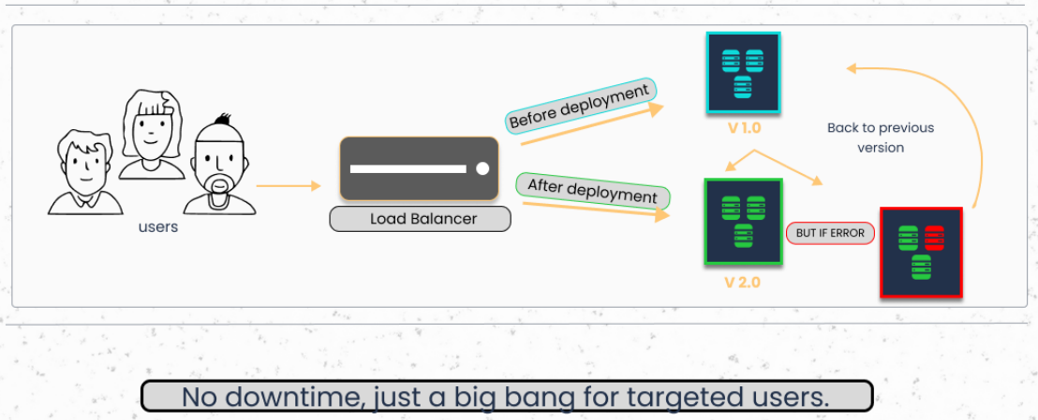
1 Big Bang Deployment

Slide 3
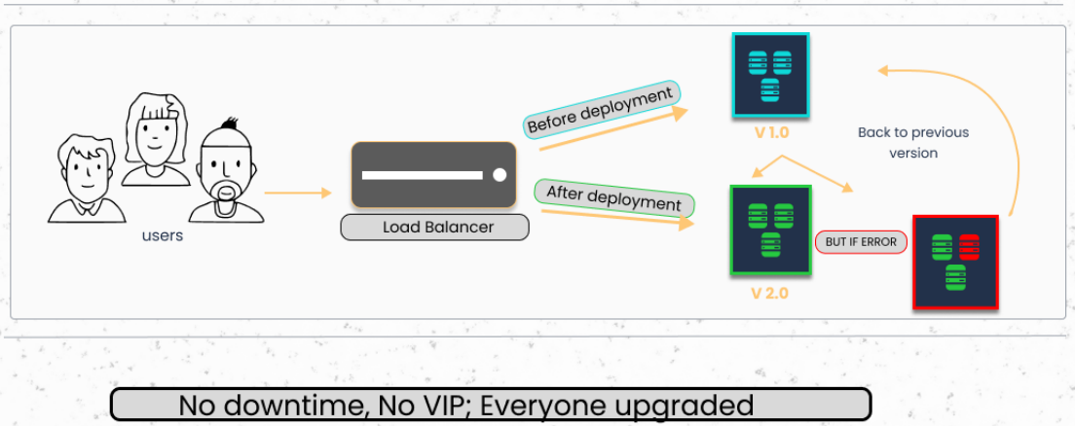
2 Rolling Deployment

Slide 4
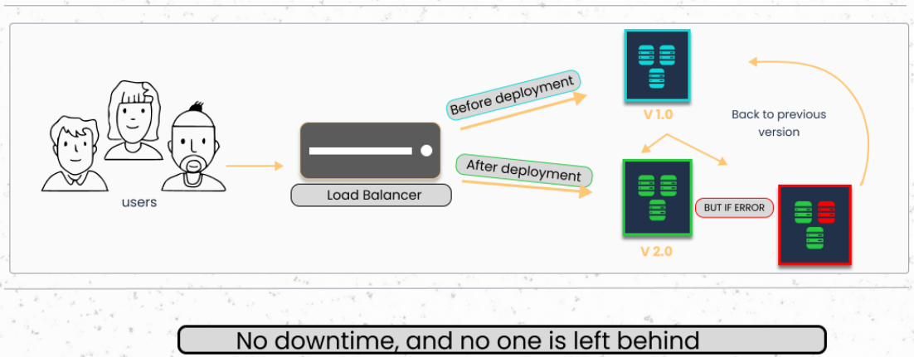
3 Blue-green Deployment

Slide 5
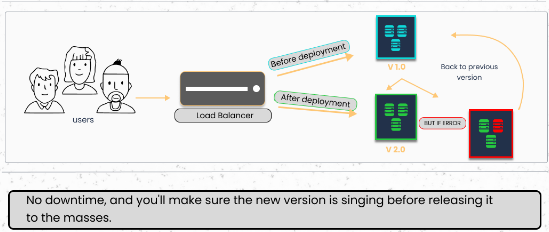
4 Canary Deployment

Slide 6
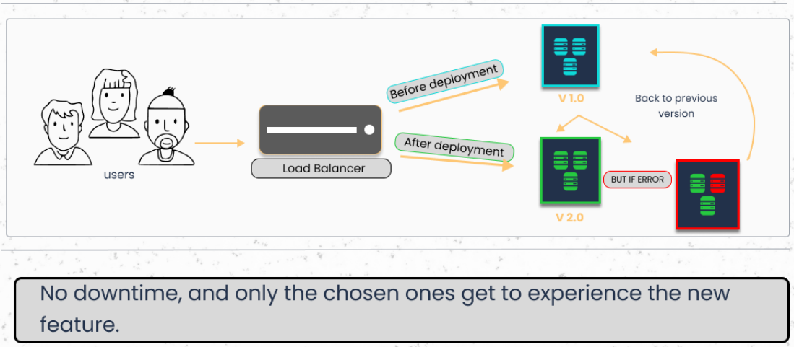
5 Feature Toggle Deployment

